Slide 1
BAN 200- ZAA Sentiment Analysis and Text Mining
Rahil Ansari | Parth Shah | Rangeetha | Melissa Pinheiro | Shivani Nanavati

Slide 2
GOAL

Slide 3
Final Group Project
Dataset used – Hotel reviews from Kaggle.
Performing Sentiment analysis on hotel reviews, to find if it’s a positive or a negative review, using two machine learning techniques - logistic regression model and Vader sentiment analyzer.
Then comparing accuracy of both results to find which model did a better job.

Slide 4
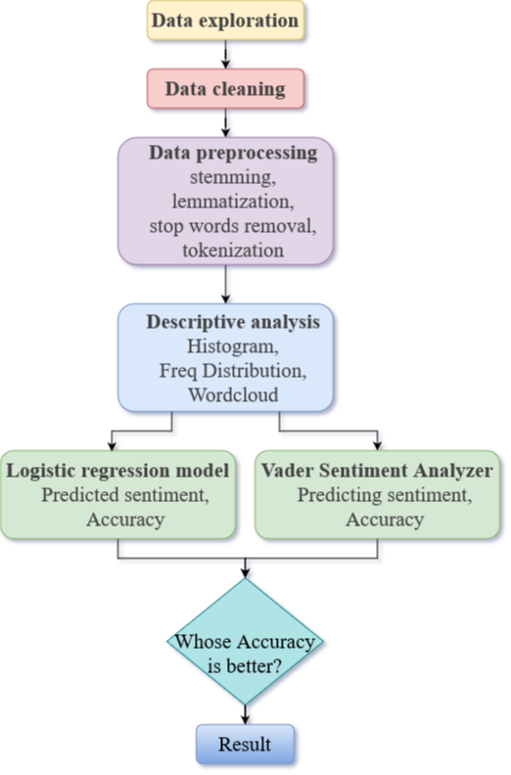
Analytical process
Steps followed for analysis:

Slide 5
Data Analysis of Text Data including Visualization
Our Approach

Slide 6
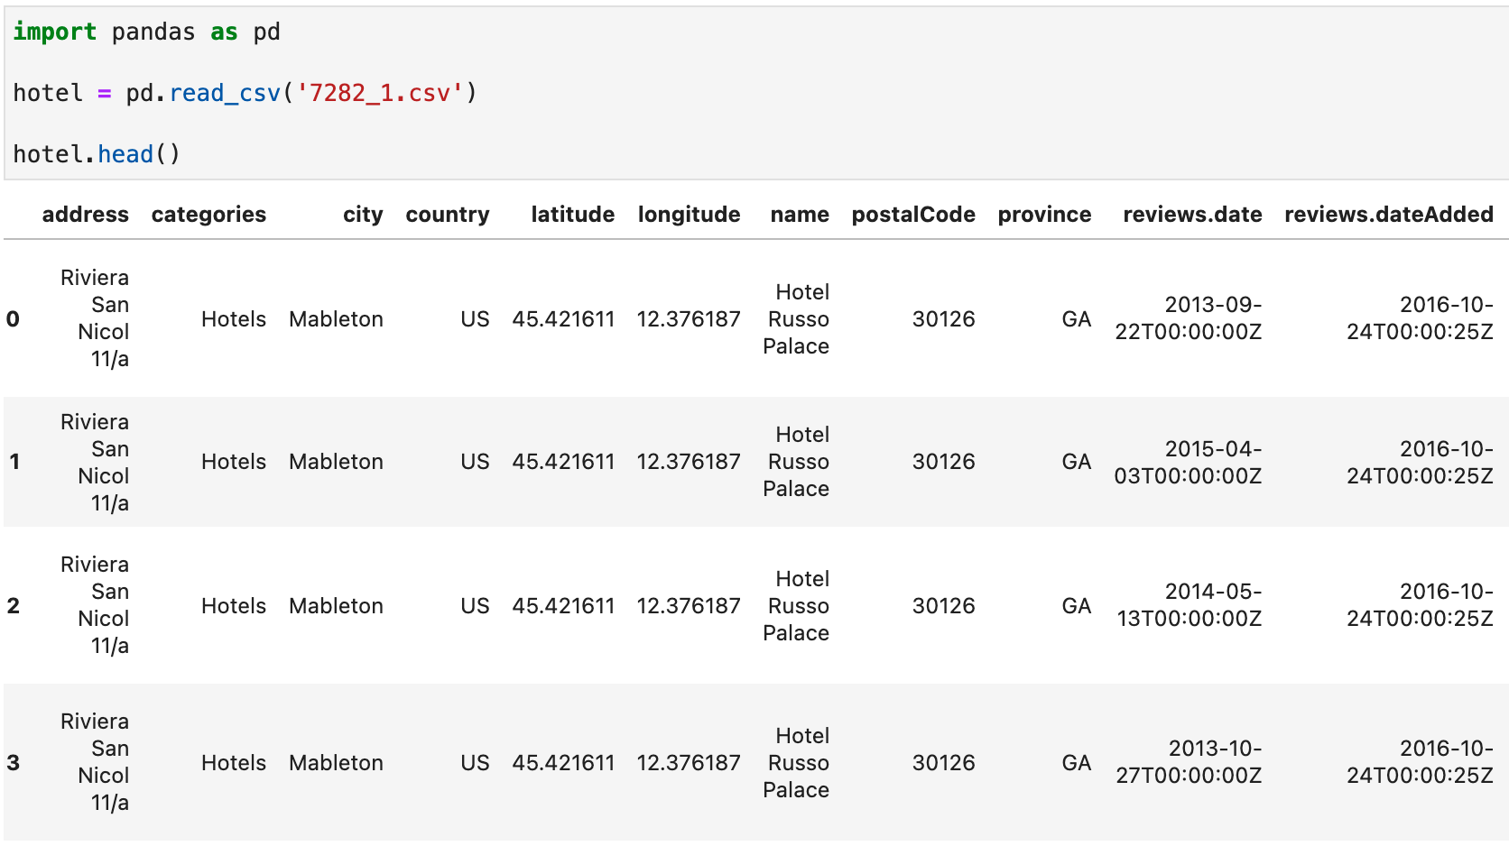
Data Loading & Cleaning
Importing the Pandas library for data frame use and reading the hotel reviews file.

Slide 7
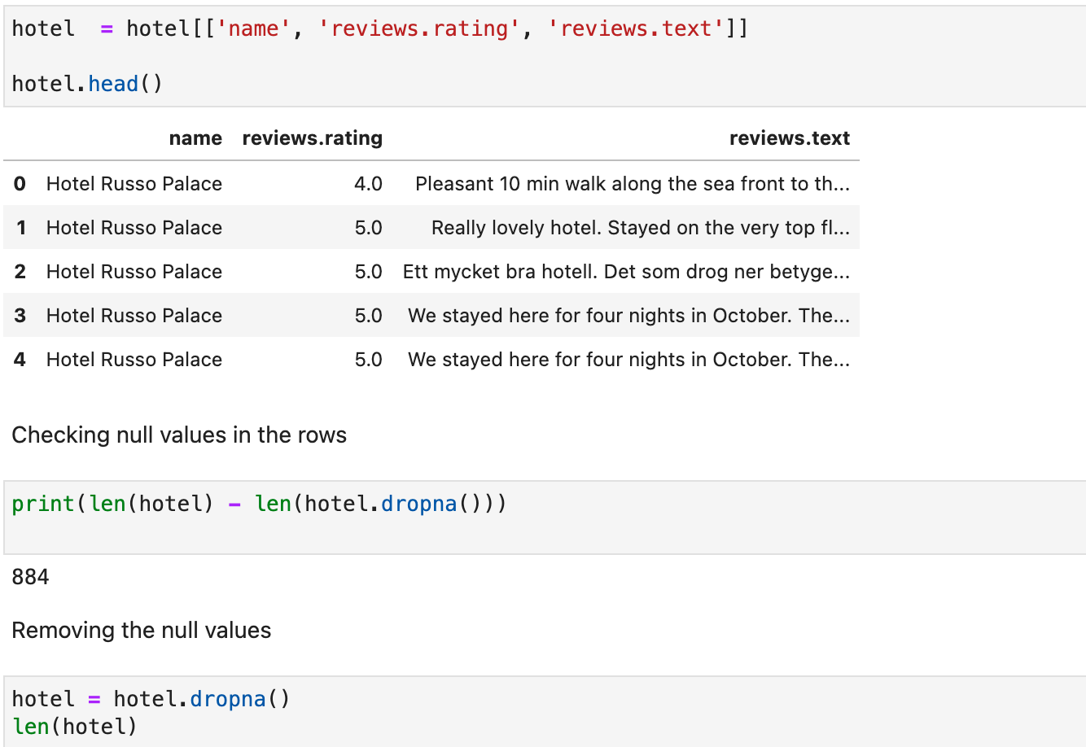
Data Loading & Cleaning
Checking for null values
Removing the null values

Slide 8
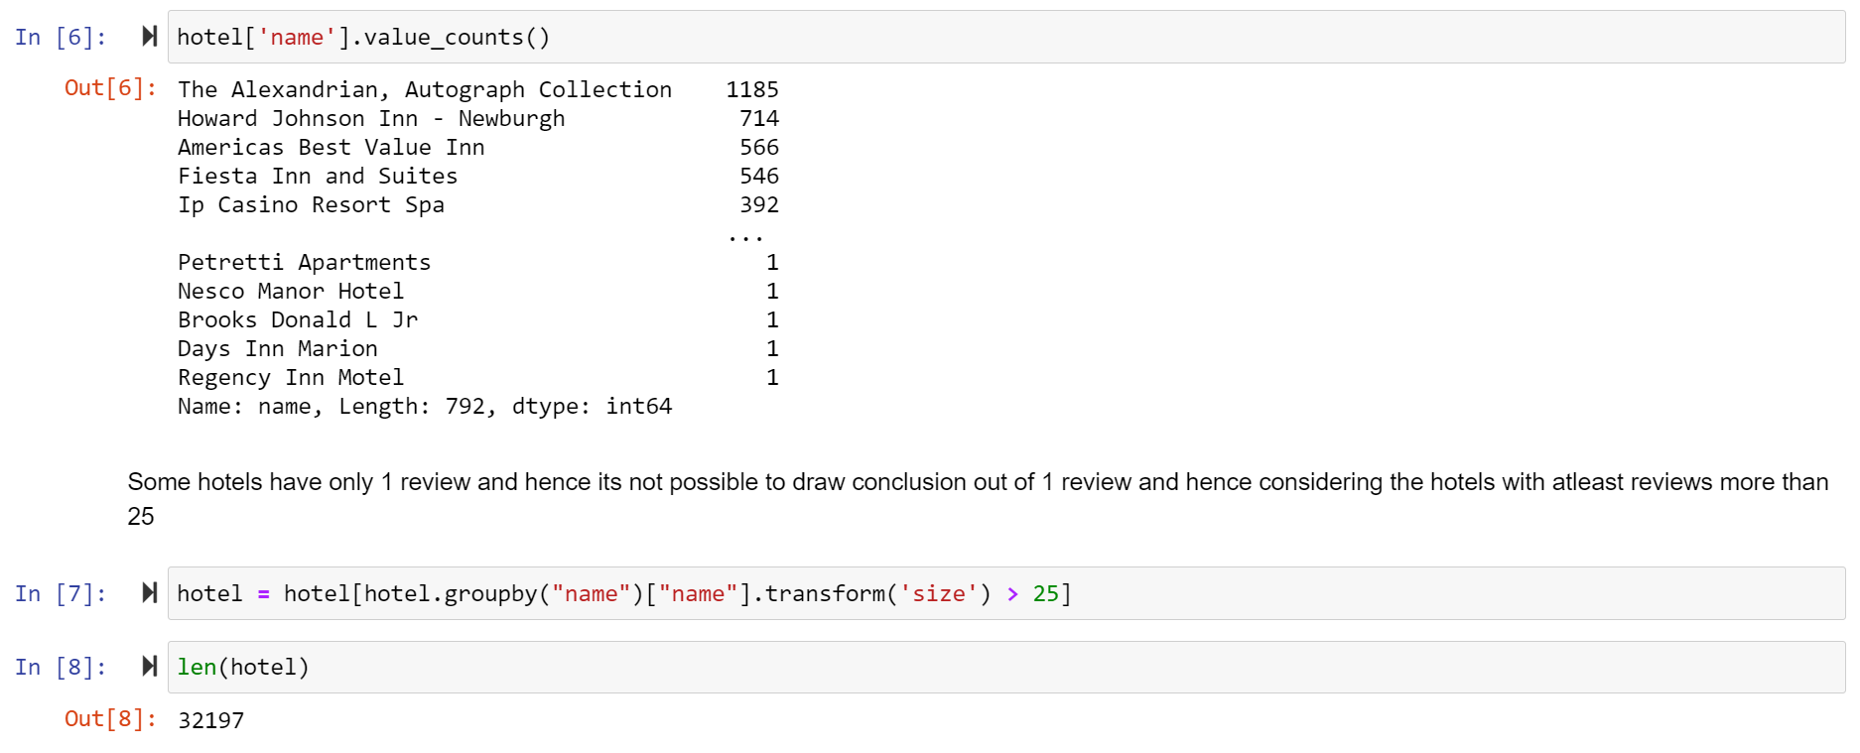
Data Loading & Cleaning
Checking the count of hotel reviews.

Slide 9
Data Loading & Cleaning
Checking the count of hotel reviews.

Slide 10
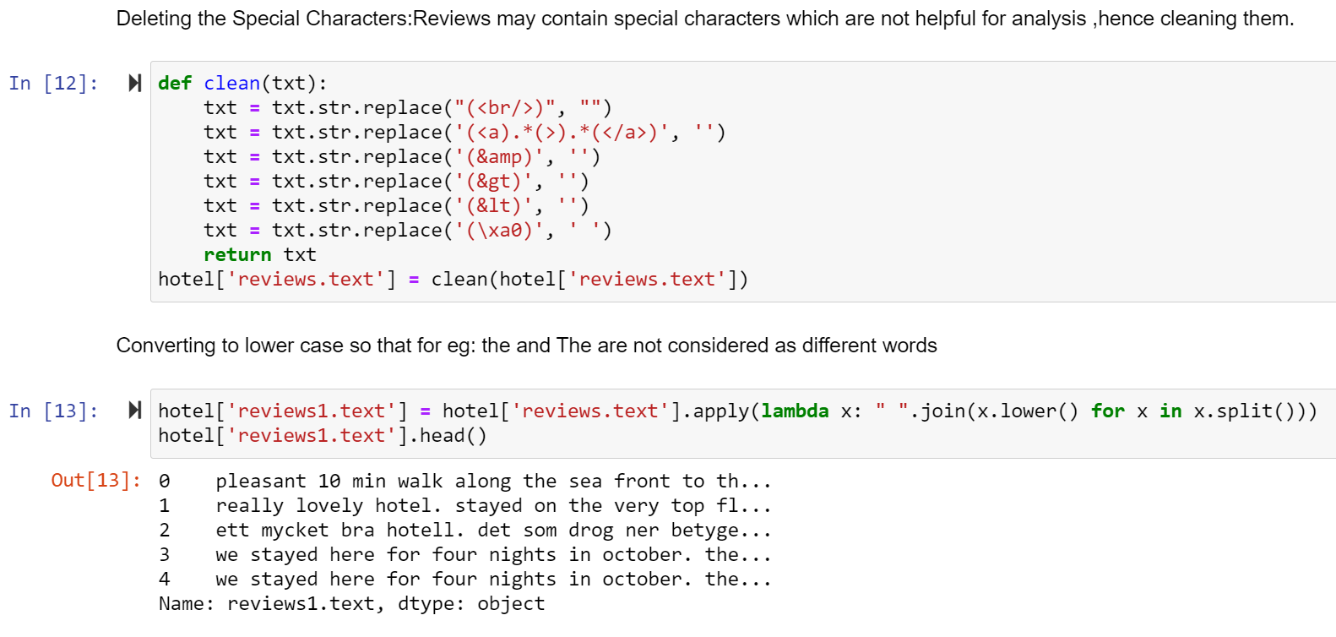
Data Preprocessing
deleting the special characters
Converting all text to lower case

Slide 11
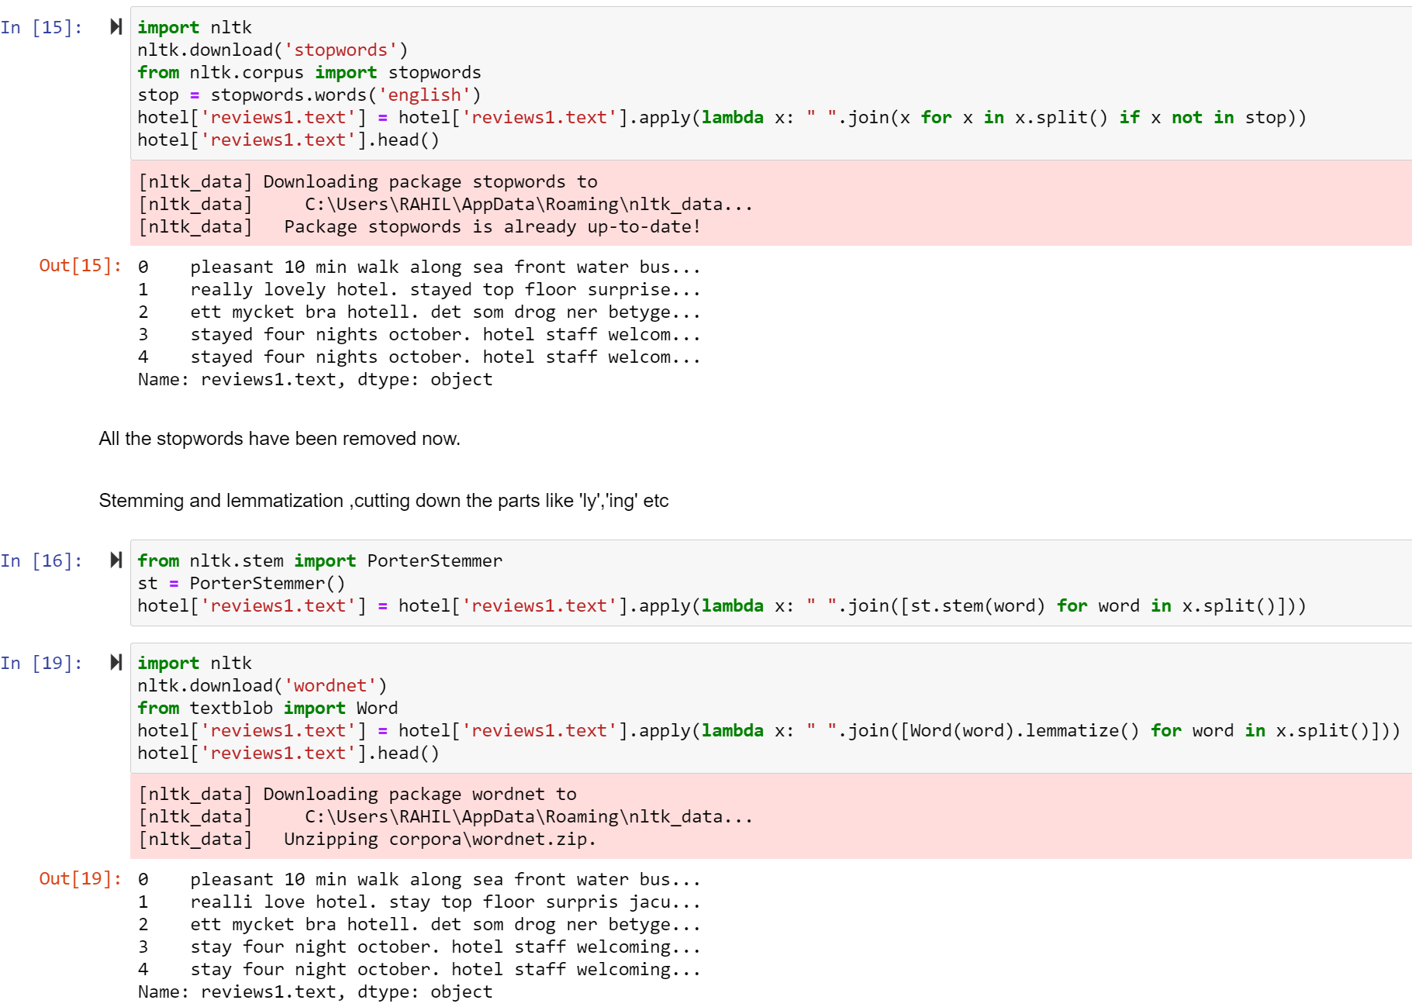
Data Preprocessing
removing stop words
stemming and lemmitization

Slide 12
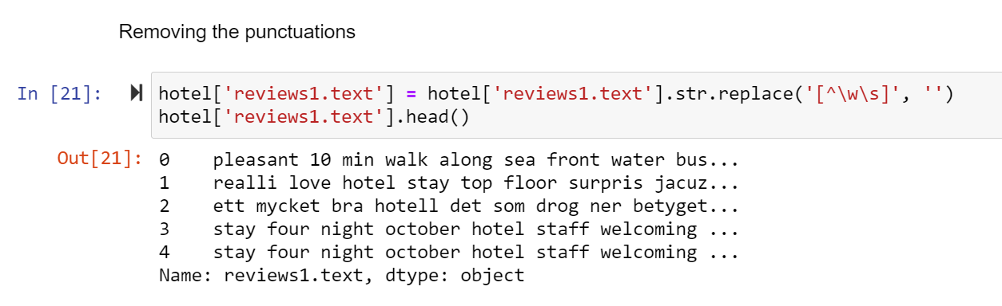
Data Preprocessing
removing the punctuations

Slide 13
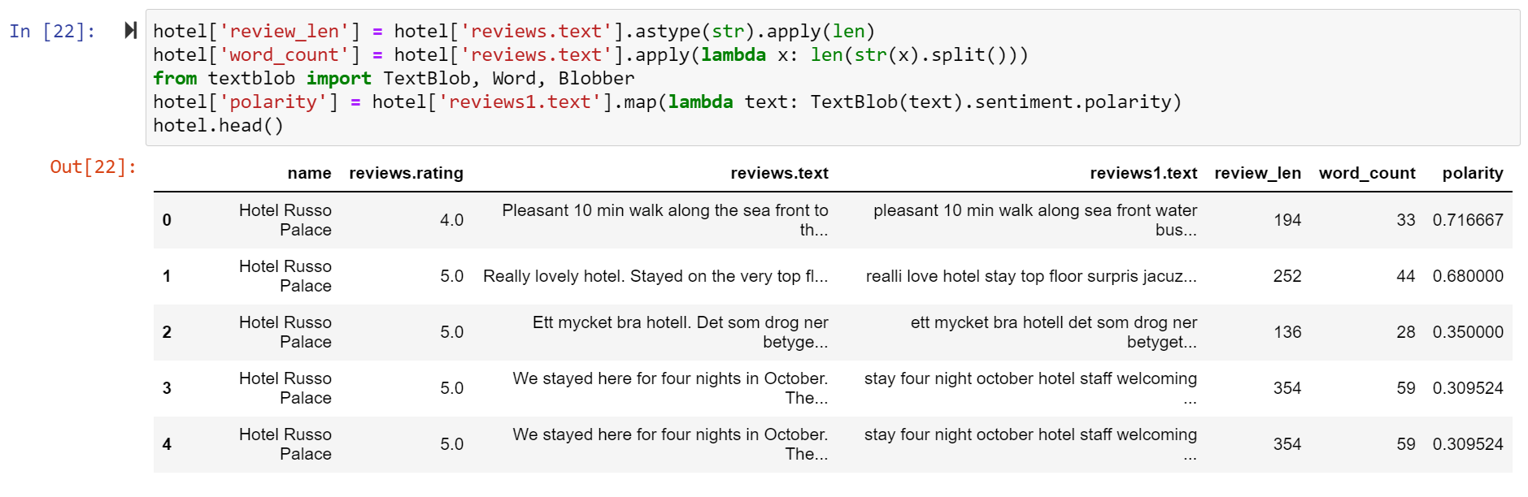
Data Analysis
adding new columns like length of the review, word count and polarity of the reviews

Slide 14
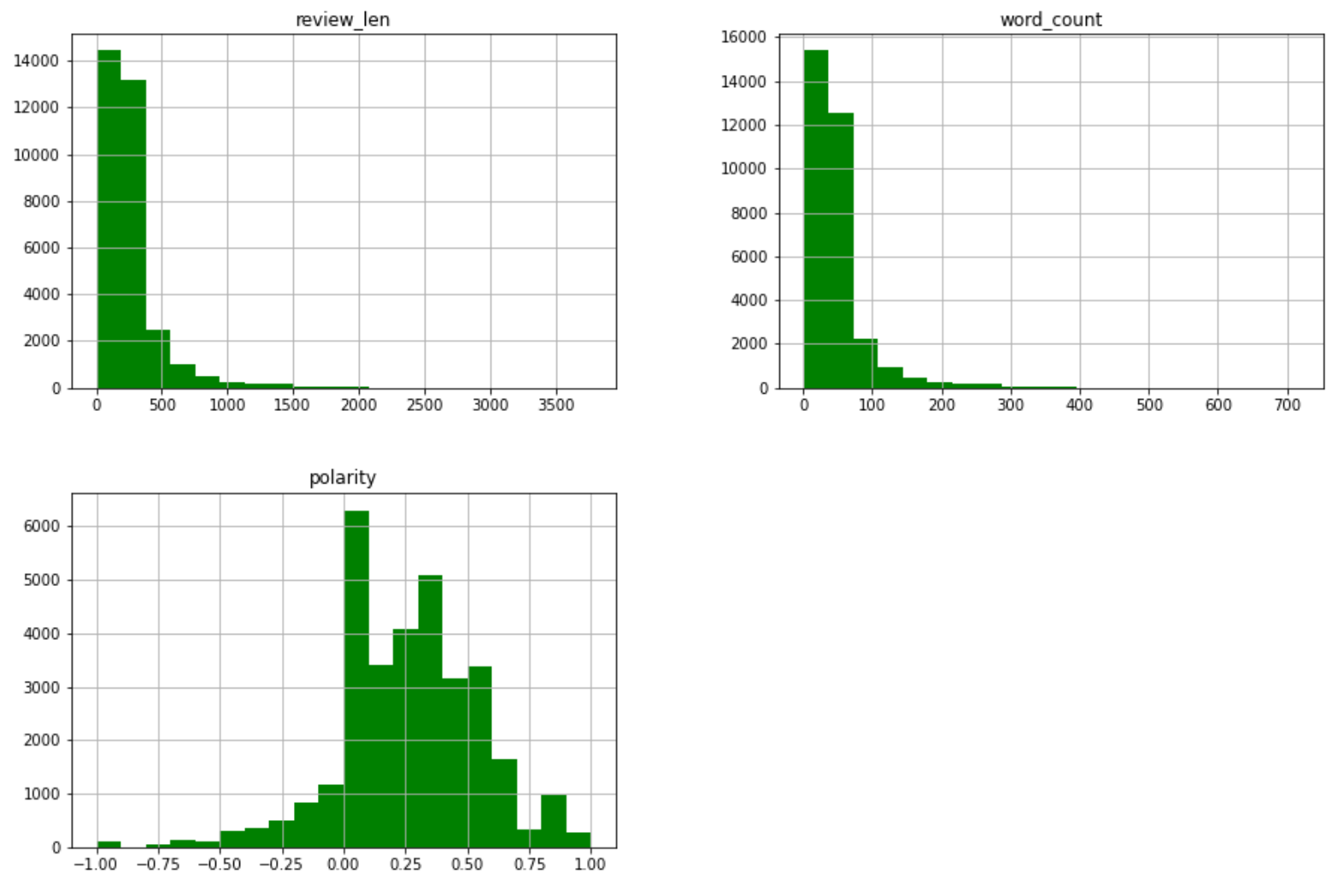
Data Analysis
Distribution of length of review, word count and polarity

Slide 15
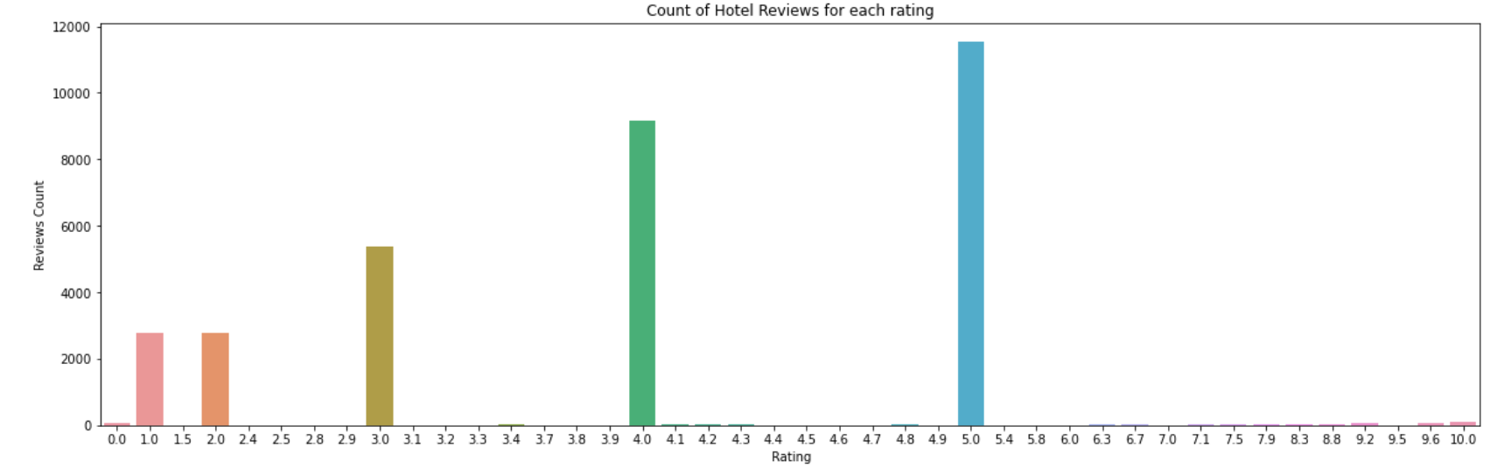
Data Analysis
Number of reviews for each rating

Slide 16
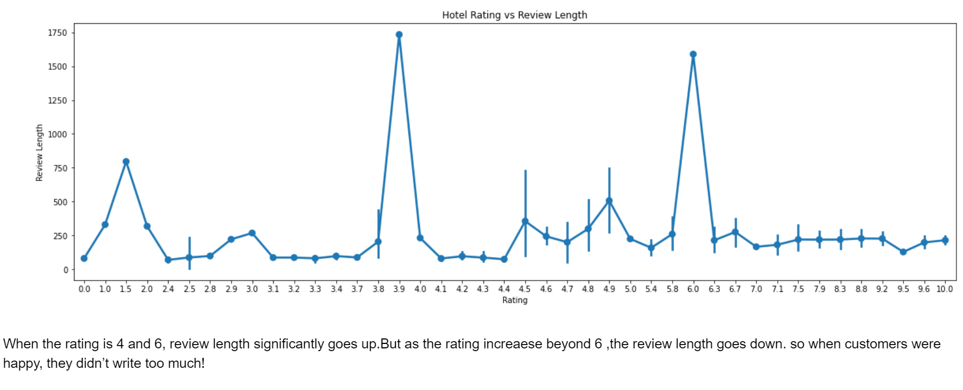
Data Analysis
Hotel ratings vs review length
Checking if review length changes with rating

Slide 17
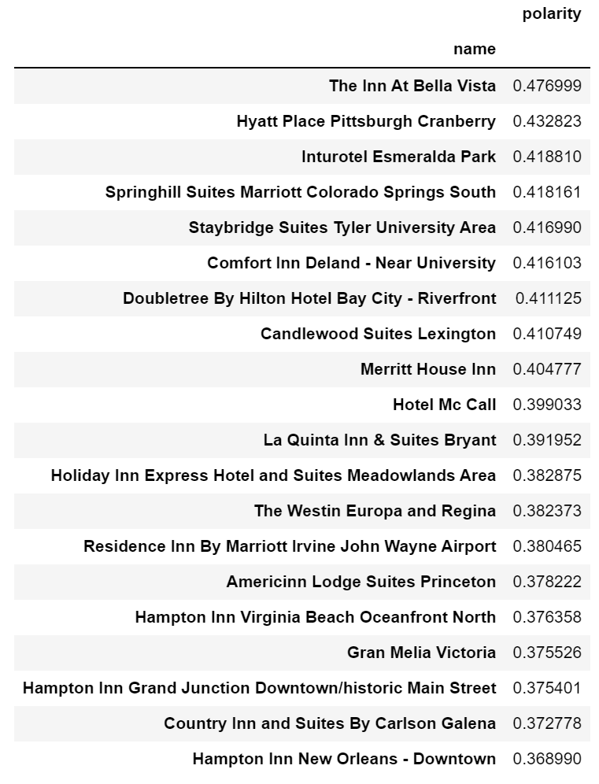
Data Analysis
The top 20 hotels based on polarity

Slide 18
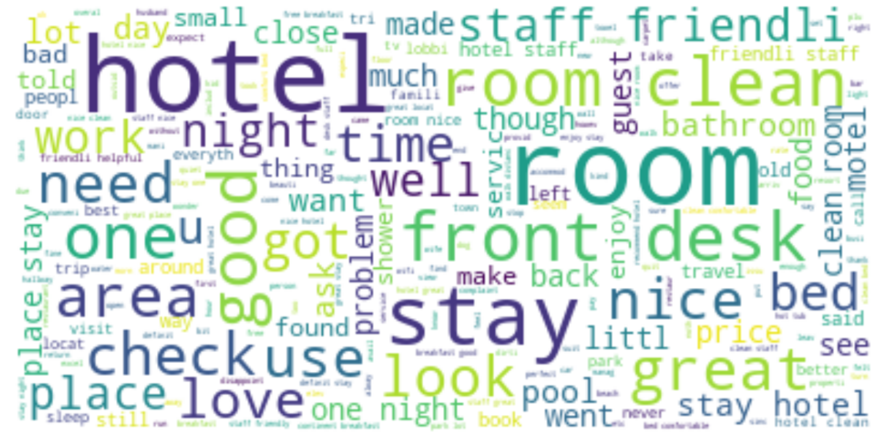
Data Analysis
Word cloud to check the frequency of words used in the reviews

Slide 19
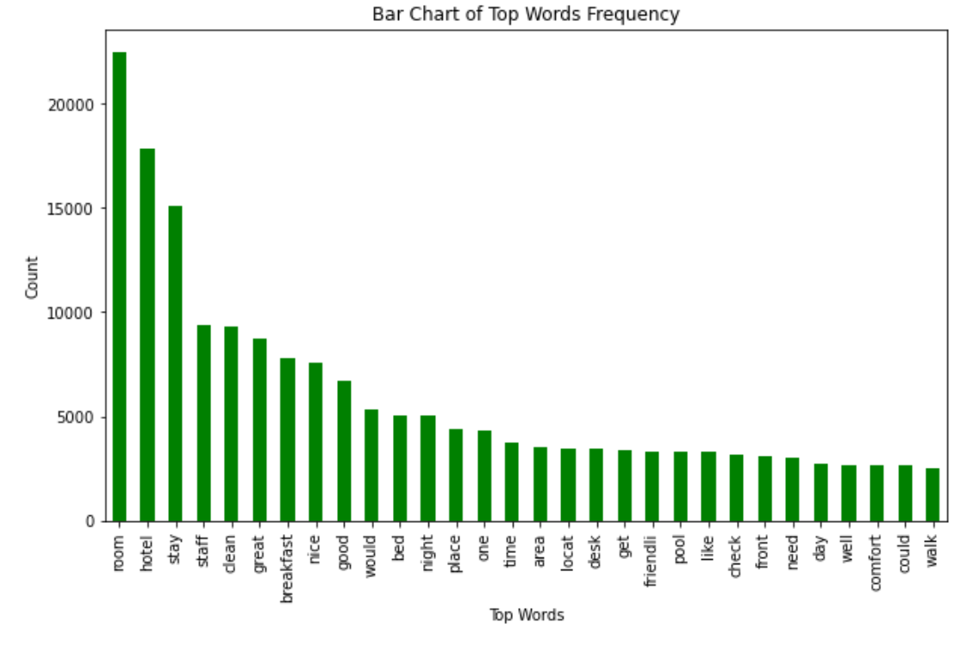
Data Analysis
The top 30 words based on frequency

Slide 20
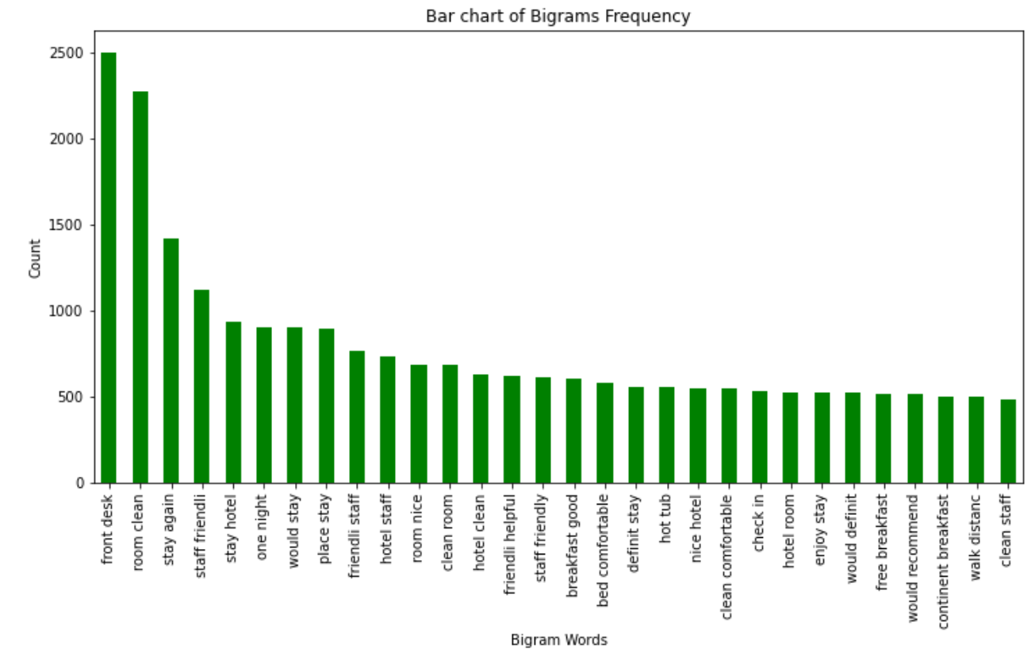
Data Analysis
The top 30 bigram words based on frequency

Slide 21
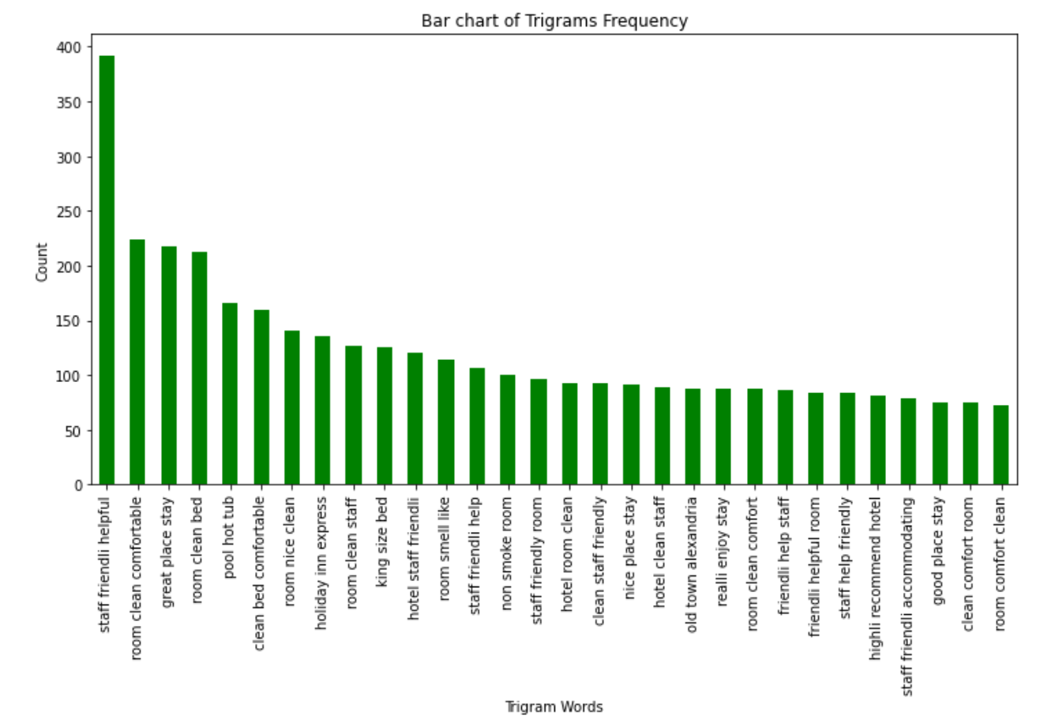
Data Analysis
The top 30 trigram words based on frequency

Slide 22
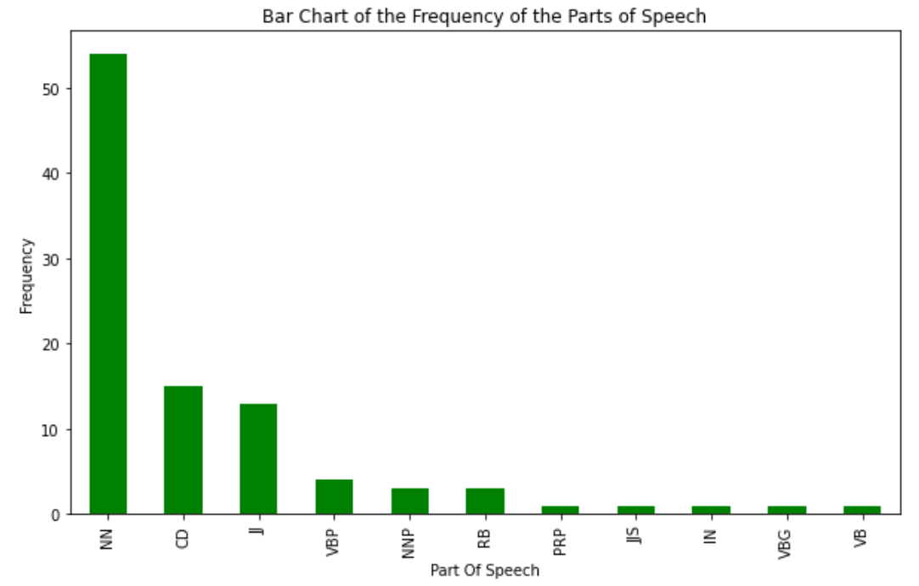
Data Analysis
Parts of speech tagging such as nouns, pronouns, verbs, adjectives etc

Slide 23
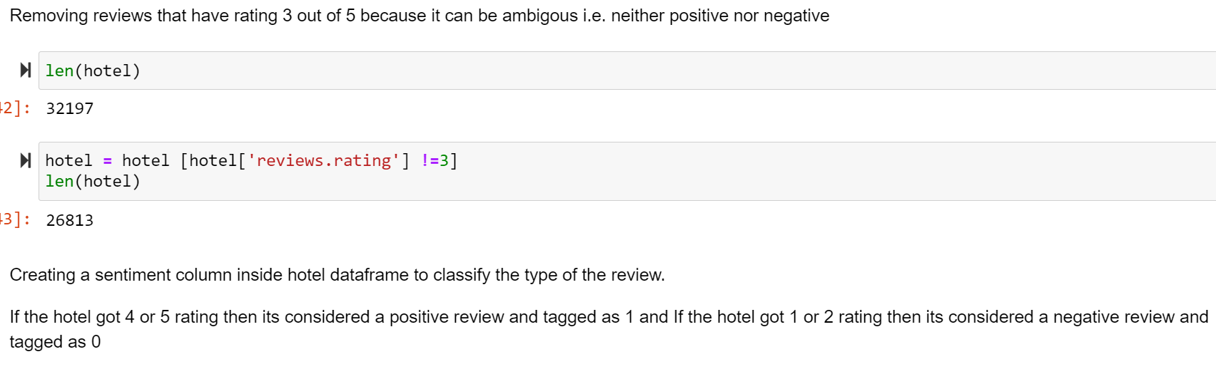
Data Analysis
Reviews with rating 3 were removed to avoid ambiguity
sentiment column created where reviews with rating 4/5 were considered positive and tagged as 1 and reviews with rating 1/2 were considered as negative and tagged as 0

Slide 24
Building the sentiment classifier- Logistic regression
Import train_test_split | Build Training and testing dataset. 7:3 ratio
Import count Vectorizer
Import LogisticRegression | classifies a review as either positive or negative based on given sentiment column and text review
model = LogisticRegression(max_iter=1000) | commanding to iterate a 1000 time to ensure better accuracy.
y_predicted = model.predict(x_test_dtm) type(y_test) | predicting value of Y( test dataset)
accuracy_score(y_test, y_predicted) | The score generated is 0.914745600873005
Notes:
The splitting of training model will help in effective mapping of inputs to output. The next step is to import count vectorizer that will help us convert review into vector/ sentiment analyzer. and this will make any kind of machine learning algorithm work smoothly. Vectorization is carried out after text cleaning in the NLP pipeline. Next is to import logistic regression, Since the goal of this project is to determine the optimum technique to analyze sentiments, we will first begin with importing logisticregression under which accuracy score in imported. The regression is made to iterate a 1000 times to ensure that model reaches convergence. After this step run the code that helps us in predcting the value of Y comparing the accuracy in the test dataset. In this case we have 91 percent accuracy. Hence, Logistic model does a good job for analyzing the sentiment of reviews as it has an impressive accuracy of 91 percent

Slide 25
VADER
Import list of positive and negative words from external sources
Perform Tokenization, stemming and text cleaning
SentimentIntensityAnalyzer() function.
‘Results’ – a variable used to store scores
results = pd.DataFrame(results.tolist())- to compound polarity
Introducing a vader sentiment column
Check accuracy. - 68 percent
Notes:
We now move to analyzing the review sentiments using the VADER library. The first step is to source a list of positive and negative words usually used in the review. The second step is to follow the NLP pipeline by performing tokenization, stemming and text cleaning that eliminates stop words for a cleaner dataset. After this process we used the function Sentiment IntensityAnalyzer to get the polarity . We created a new variable that stores the score called results. The next step is to Convert the results series to a dataframe so that the compound polarity score could be used to check whether review is positive or negative but it is also necessary to remember that compound column has no null values and number of compound scores is equivalent to number of reviews. Introducing a vader sentiment column to hotel dataframe again to classify the type of the review.If compound score of hotel is above 0 then its a positve reveiw and 1 is assigned to vader_sentiment column and If the compound score of hotel is below 0 then its a positve reveiw and 0 is assigned using the if-else condition statement and then checking accuracy. In this case it is 68 percent

Slide 26
OUTCOME
Vader sentiment analyzer – 68% Accuracy
logistic regression model which was 91.47%.
The two rational –
Ambiguity
Noise in the dataset.
Notes:
t can be seen that accuracy of the results from Vader sentiment analyzer are 68.46 % which is lower in comparision to accuracy of results from our logistic regression model which was 91.47%. There seems to be two reasons for lower accuracy for Vader sentiment analyzer
Ambiguity - vader sentiment analyzer classified a 19 thousand 8 hundred 26 reviews as positive while the logistic model classifed 18 thousand 4 hundred 25 reviews as positive. It means that certain words that would be considered non positive were considered as positive because of their ambigous nature.
Noise in the dataset - As reviews are user input texts, they naturally have noise in them. We tried to preprocess and remove noise from data but evidently it weakened the accuracy of our model.

